Slide 1

HOHUTA
COFFEE SHOP
Group members
Dang Van Gia Huy
Ngo Duc Tai
Hoang Van Hoan

Slide 2

Name of our website
Something about our website
HoHuTa Coffee Shop
Domain
http://hohutacoffeeshop.atwebpages.com
Content
About the coffee shop website
Programming language
HTML, Java Script, PHP,CSS, Bootstrap, jQuery, ...
Hosting and Database Manager Website
https://www.awardspace.com/

Slide 3


Our material for all pages
Thumbnail + navbar
Footer

Slide 4
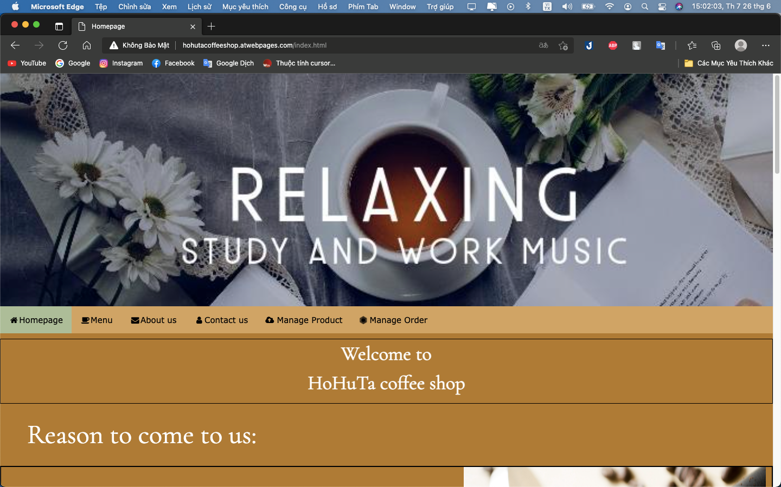
Homepage
That is the main page of our website
In this page, we will introduce some details about our website such as : High quality coffee, dessert, music and some products are the best seller of our shop

Slide 5
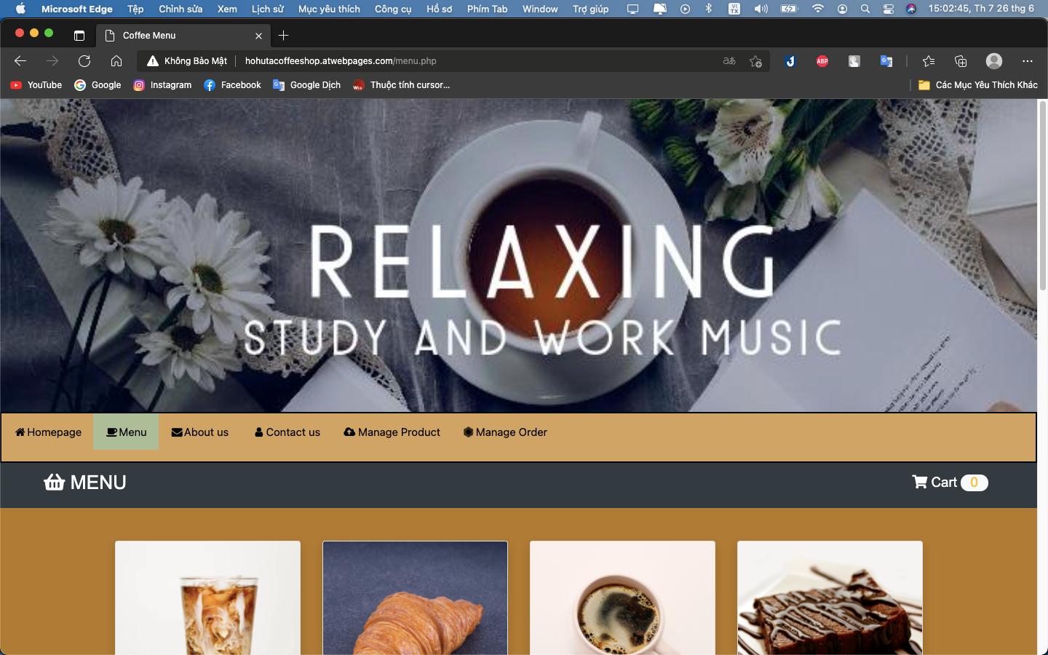
Menu
That is the page to list products and allow customers to order
In this page, we will show you some images and price, description of the menu. Customers can order here.

Slide 6
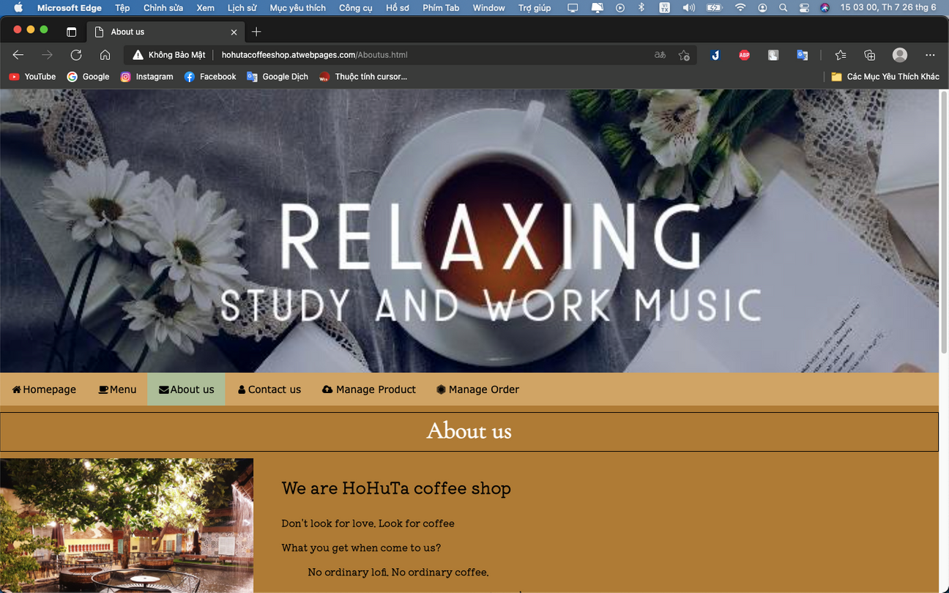
About us
In this page, we will show you some details about the shop and owners
Having some slogans of our shop.
And the pictures of 3 owners

Slide 7
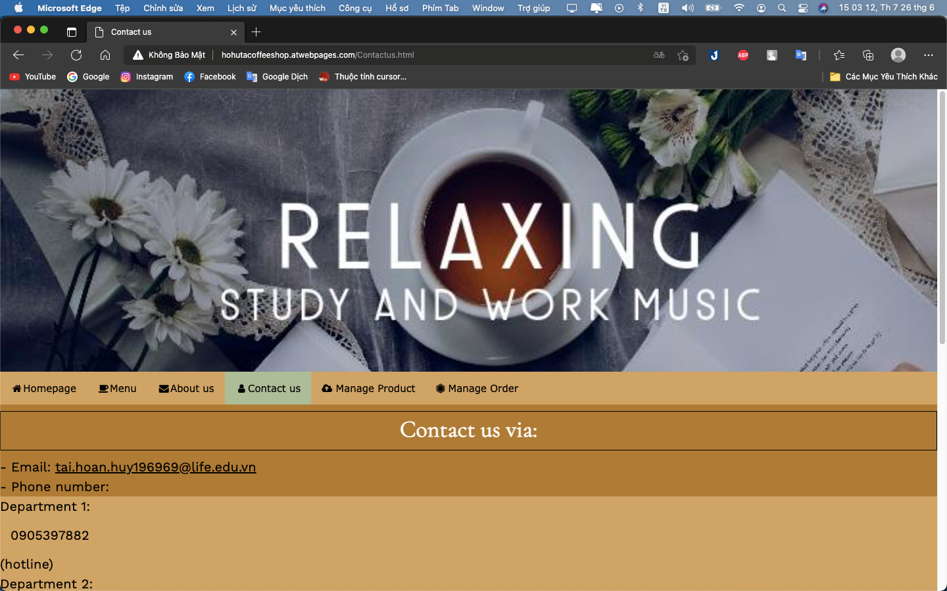
Contact us
Some contact address for you to chat with us
We have email, address, phone number and a form that helps you to contact us easily.

Slide 8
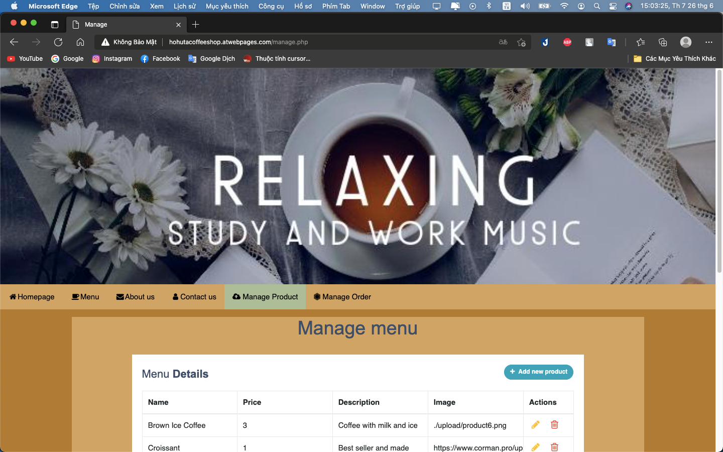
Only for admin
Manage product
Admins use this page to manage menu
Admin can change the name, price, description, image. Admins are available to add or remove product.

Slide 9
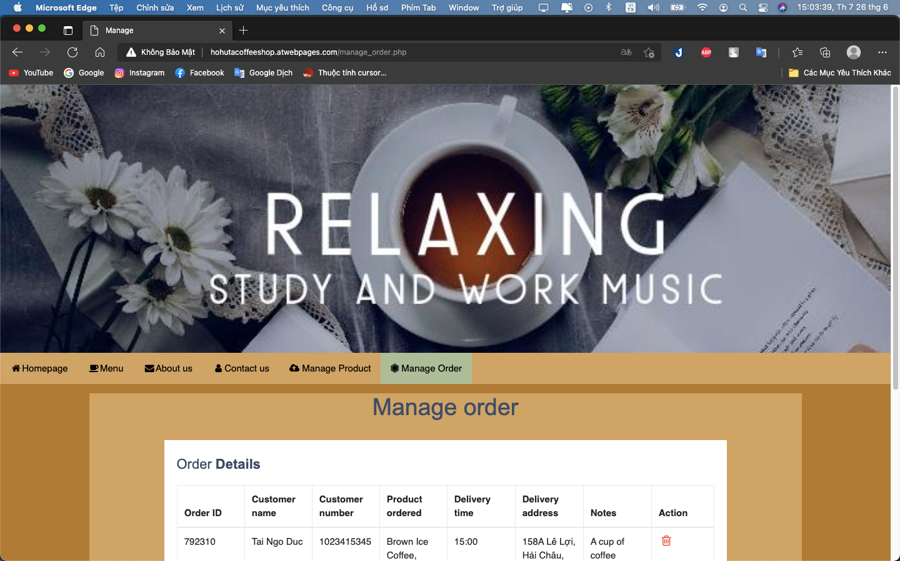
Only for admin
Manage Order
Admins use this page to manage order
Admin can see the order ID, customer name, phone number, product order, delivery time. Admin can remove the order.

Slide 10
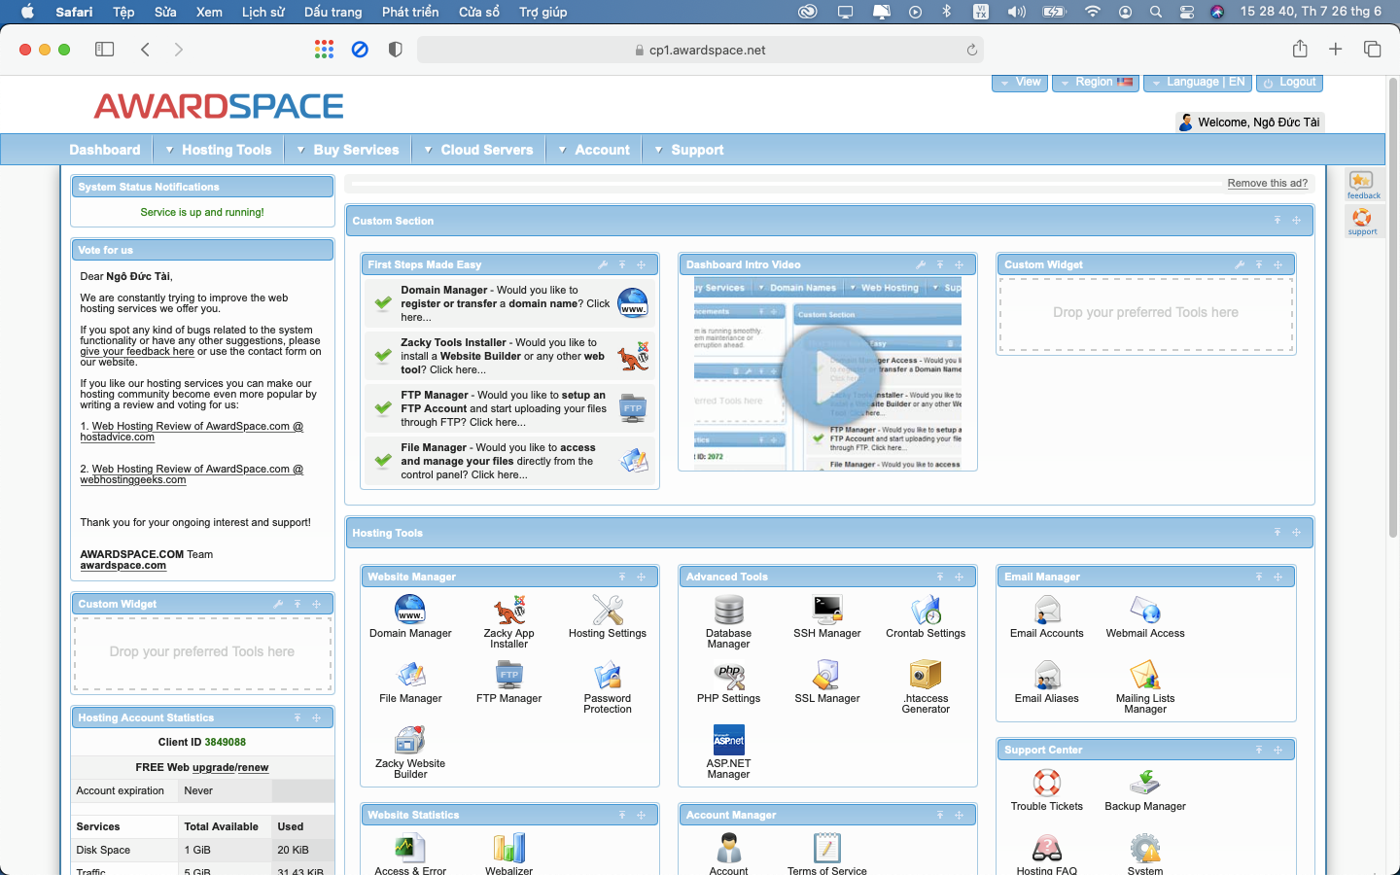
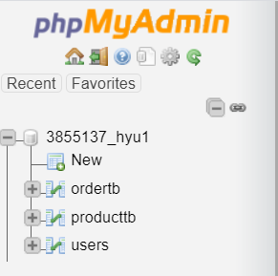
The website we use to host and create database

Slide 11

Thank you

